Slide 1
Cost estimation
SUBMITTED BY
T.JANANI(2018506040)
C.ANUCHITRA(2018506018)
J.RENUKHA(2018506093)

Slide 2
TOOL USED :GANTTPRO OPEN SOURCE TOOL
TOPIC CHOOSEN:DIETARY MANAGEMENT

Slide 3

GANTTPRO LOGO
I

Slide 4
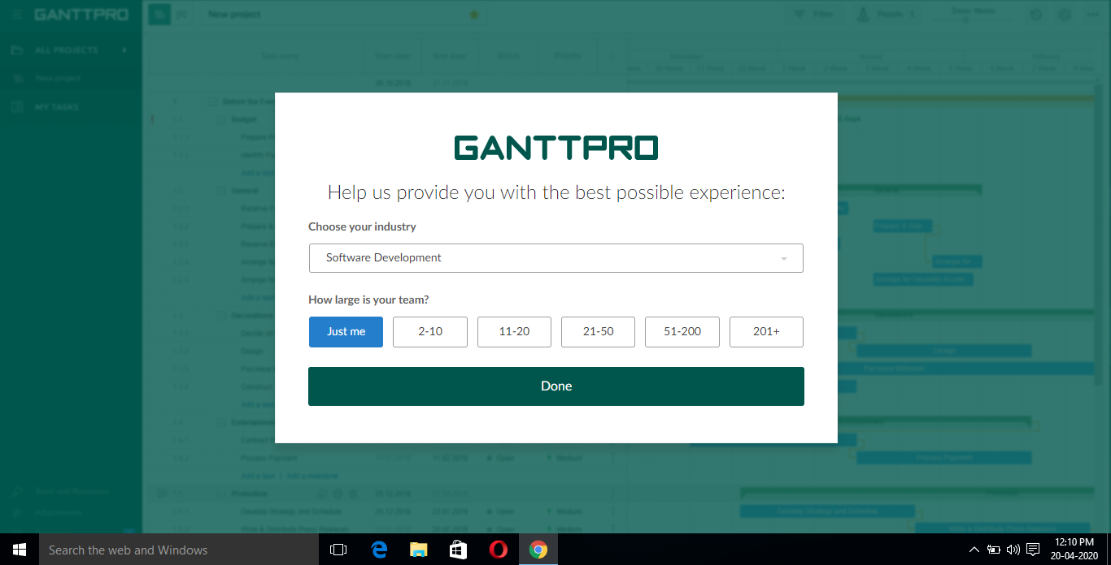
PROVIDES OPTION FOR DIFFERENT CONSTRUCTION ESTIMATION

Slide 5
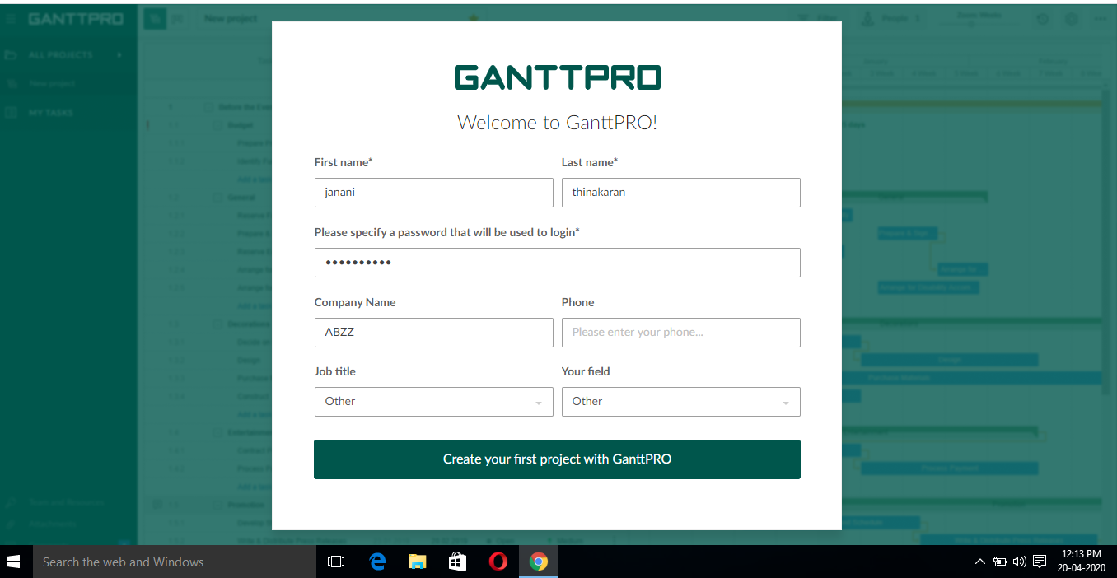
USER PROFILE

Slide 6
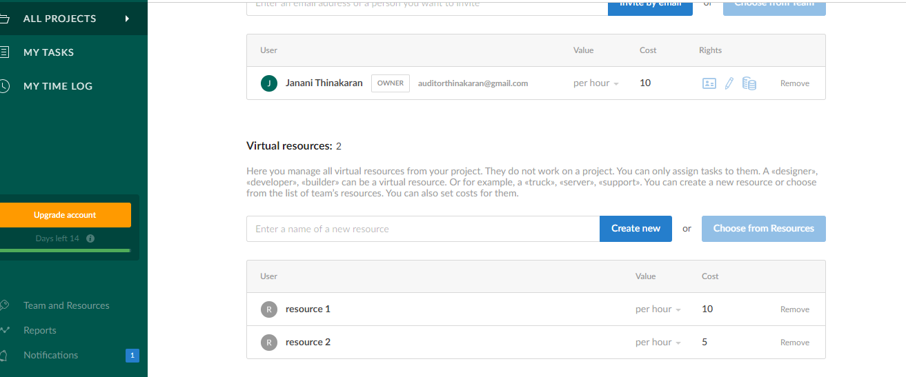
DETAILS OF THE OWNER AND RESOURCES AVAILABLE

Slide 7
TASKS
LOGIN
ENTER USERNAME
ENTER PASSWORD
GO TO MAIN PAGE
MAIN PAGE
CHOOSE YOUR PAGE OF INTEREST
DIRECTED TO THE SELECTED PAGE
TRAIINER
ENTER DETAILS
MEMBERSHIP
ENTER DETAILS
BMI AND CALORIE CALCULATION
ENTER THE REQUIRED DETAILS
AND CALCLATING

Slide 8
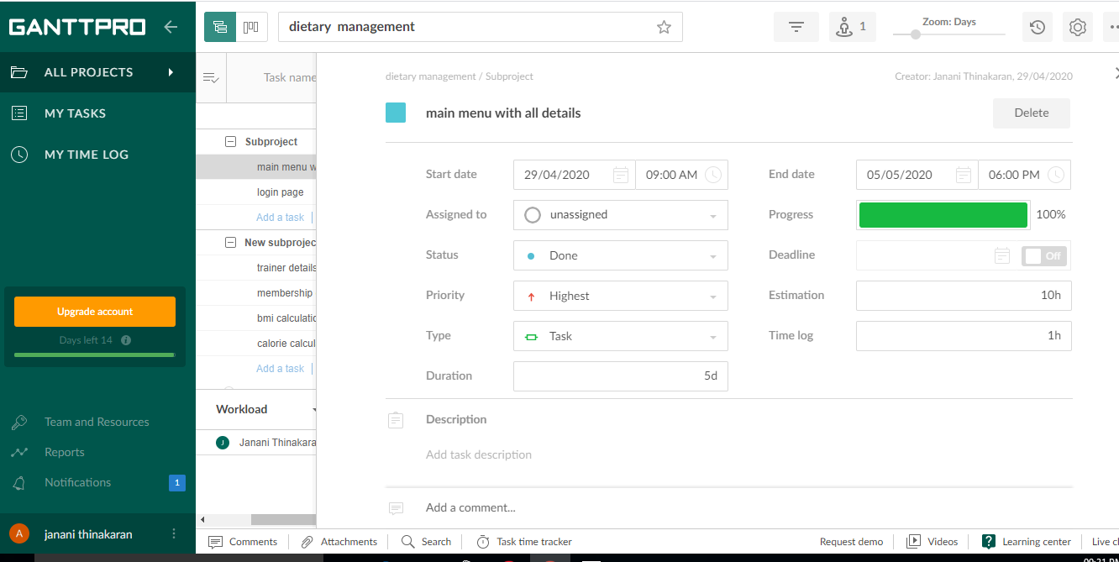

Slide 9
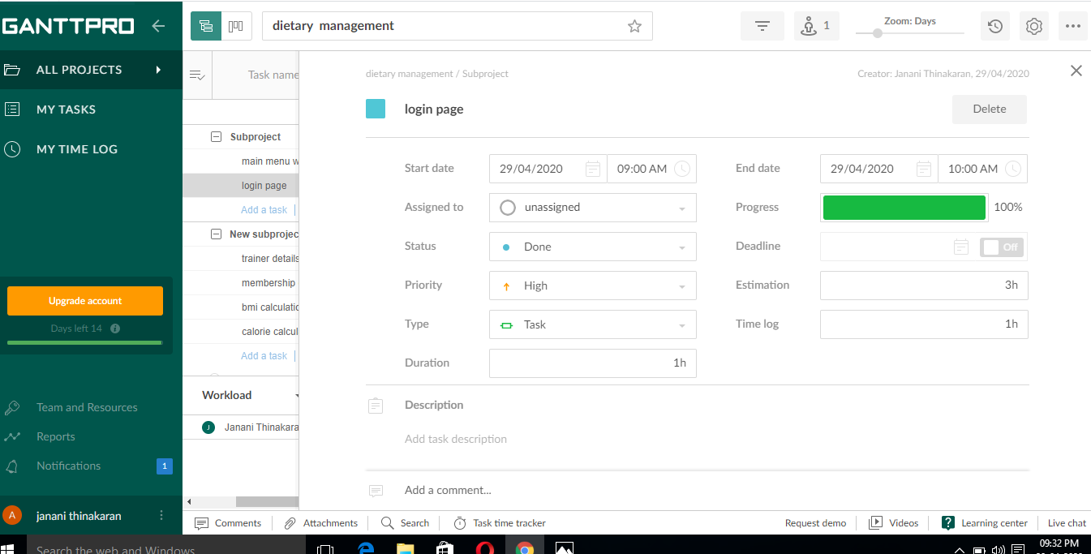

Slide 10
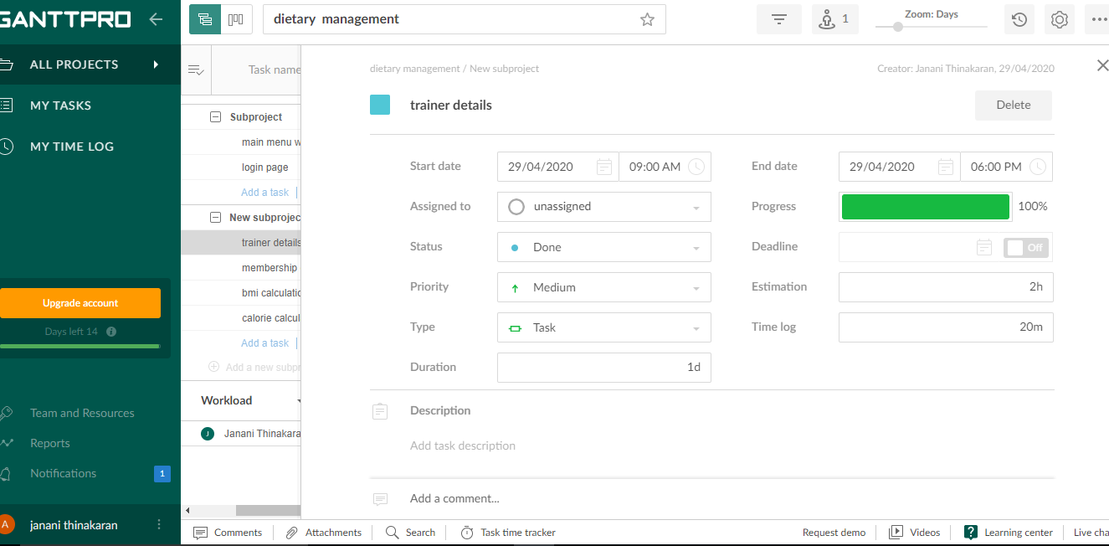

Slide 11
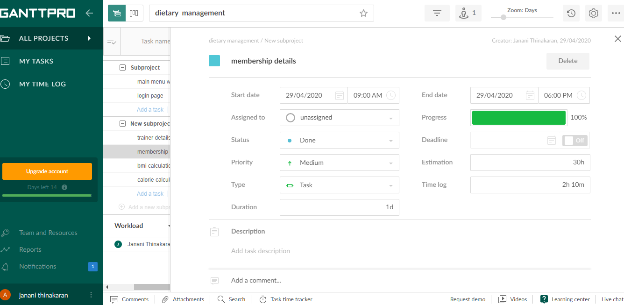

Slide 12
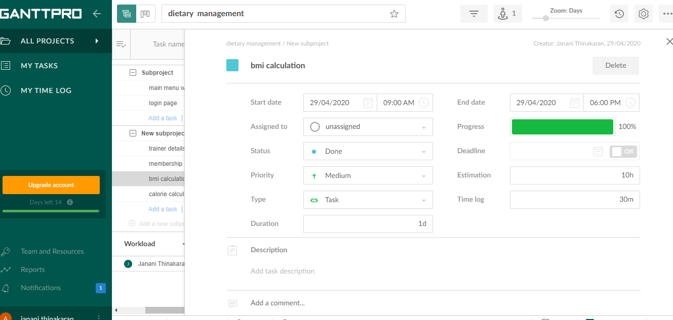

Slide 13
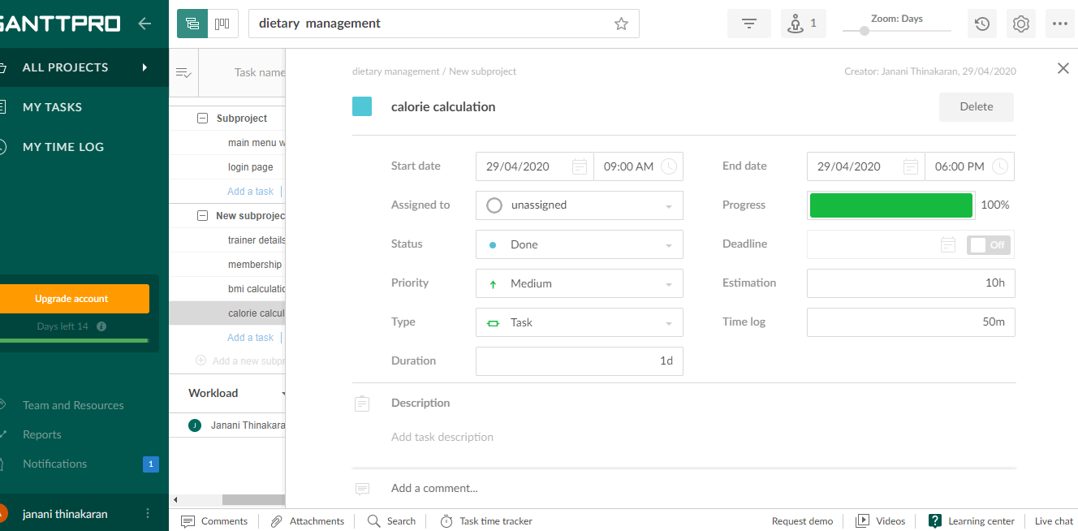

Slide 14
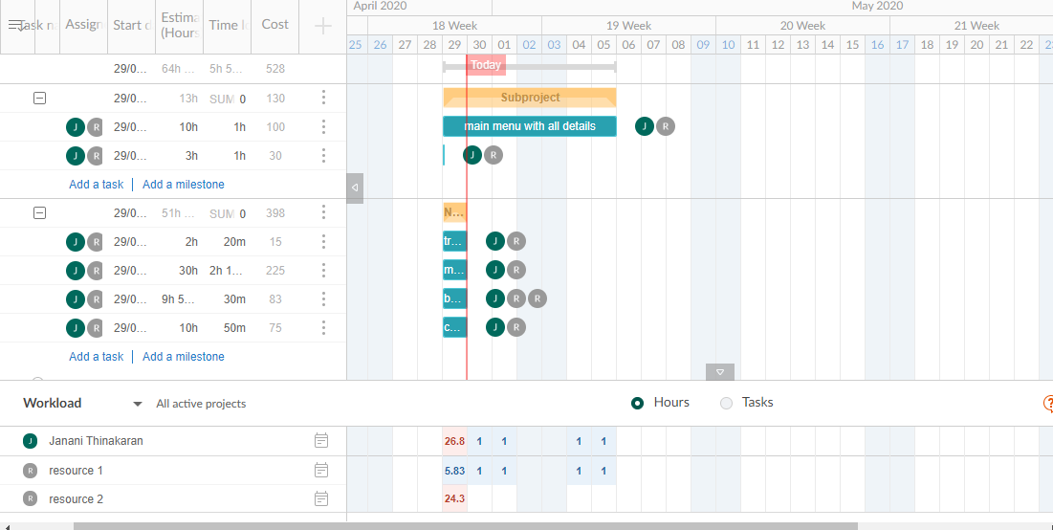

Slide 15
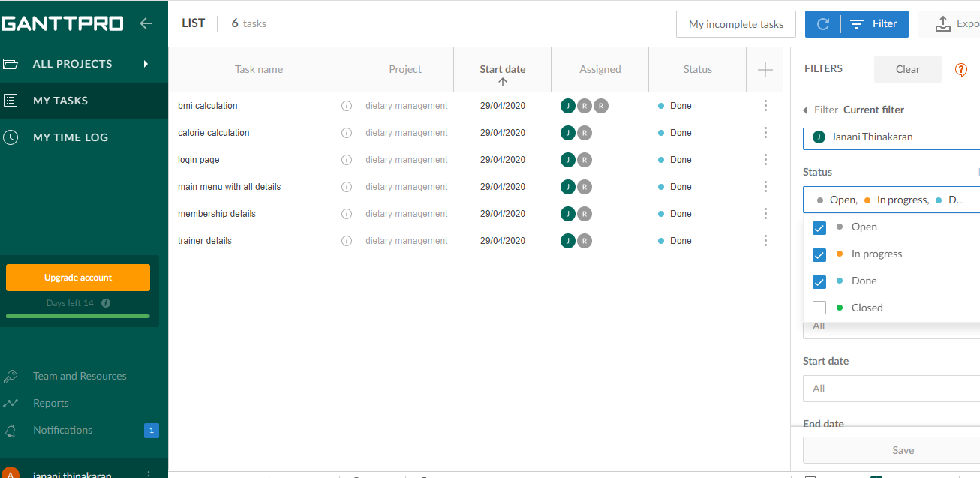

Slide 16
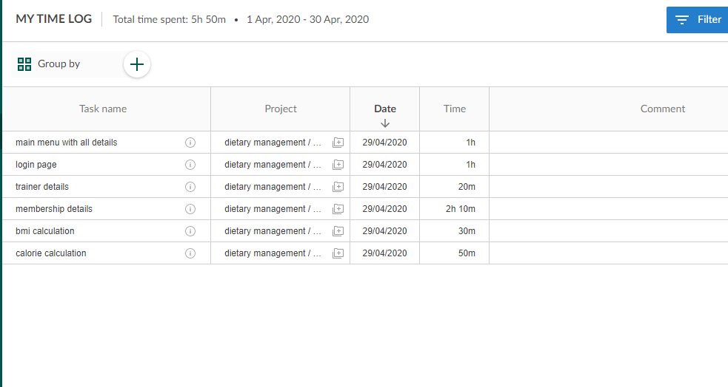

Slide 17
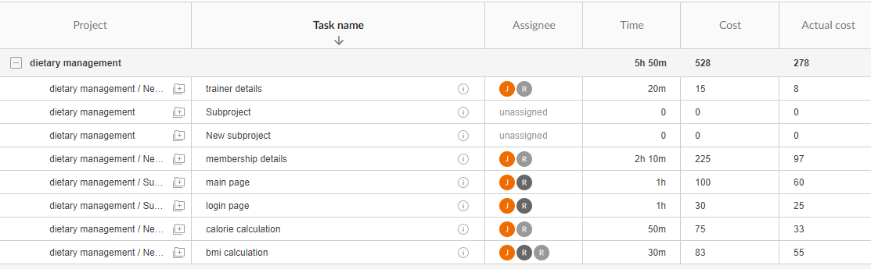
Budget analysis

Slide 18
Thank you….

